Slide 1
CSS BOX MODEL

Slide 2
INTRODUCTION
In CSS, the term "box model" is used when talking about design and layout.
The CSS box model is essentially a box that wraps around every HTML element.

Slide 3
It consists of:
Margins
Borders
Padding
Content

Slide 4
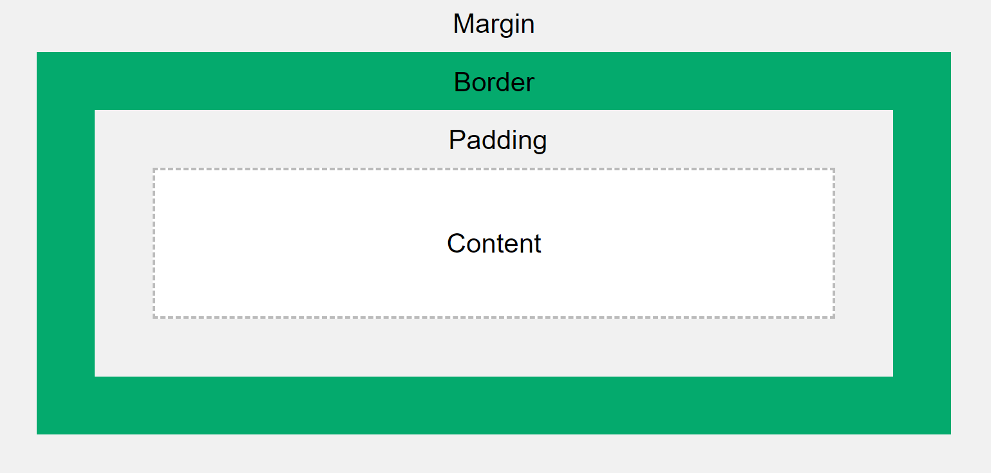

Slide 5
MARGINS
Used to create space around elements, outside of any defined borders.
Margin properties can have negative values in order to deliberately overlap content.
Margin properties will affect the position of background elements in relation to the edges of the containing block element.

Slide 6
MARGIN consists of:
Left Margin
Right Margin
Top Margin
Bottom Margin

Slide 7
PADDING
Padding defines the space around elements inside the border; i.e. between the border and the content itself.
Padding properties cannot have negative values.
Padding properties do not affect the position of background elements in the containing block element; only the position of content.

Slide 8
Padding consists of:
Left Padding
Right Padding
Top Padding
Bottom Padding

Slide 9
MARGIN AND PADDING
HTML
<body>
<div>
Yellow Is the color of gold, butter and ripe lemons. In the spectrum of visible light, yellow is found between green and orange.
</div>
</body>
CSS
div {
Border: 4px solid rgb(47, 90, 119);
margin-top:0;
margin-left: 195px;
margin-bottom: 60px;
margin-right: 100px;
padding-left: 80px;
padding-top: 70px;
padding-bottom: 60px;
padding-right: 50px;
}

Slide 10
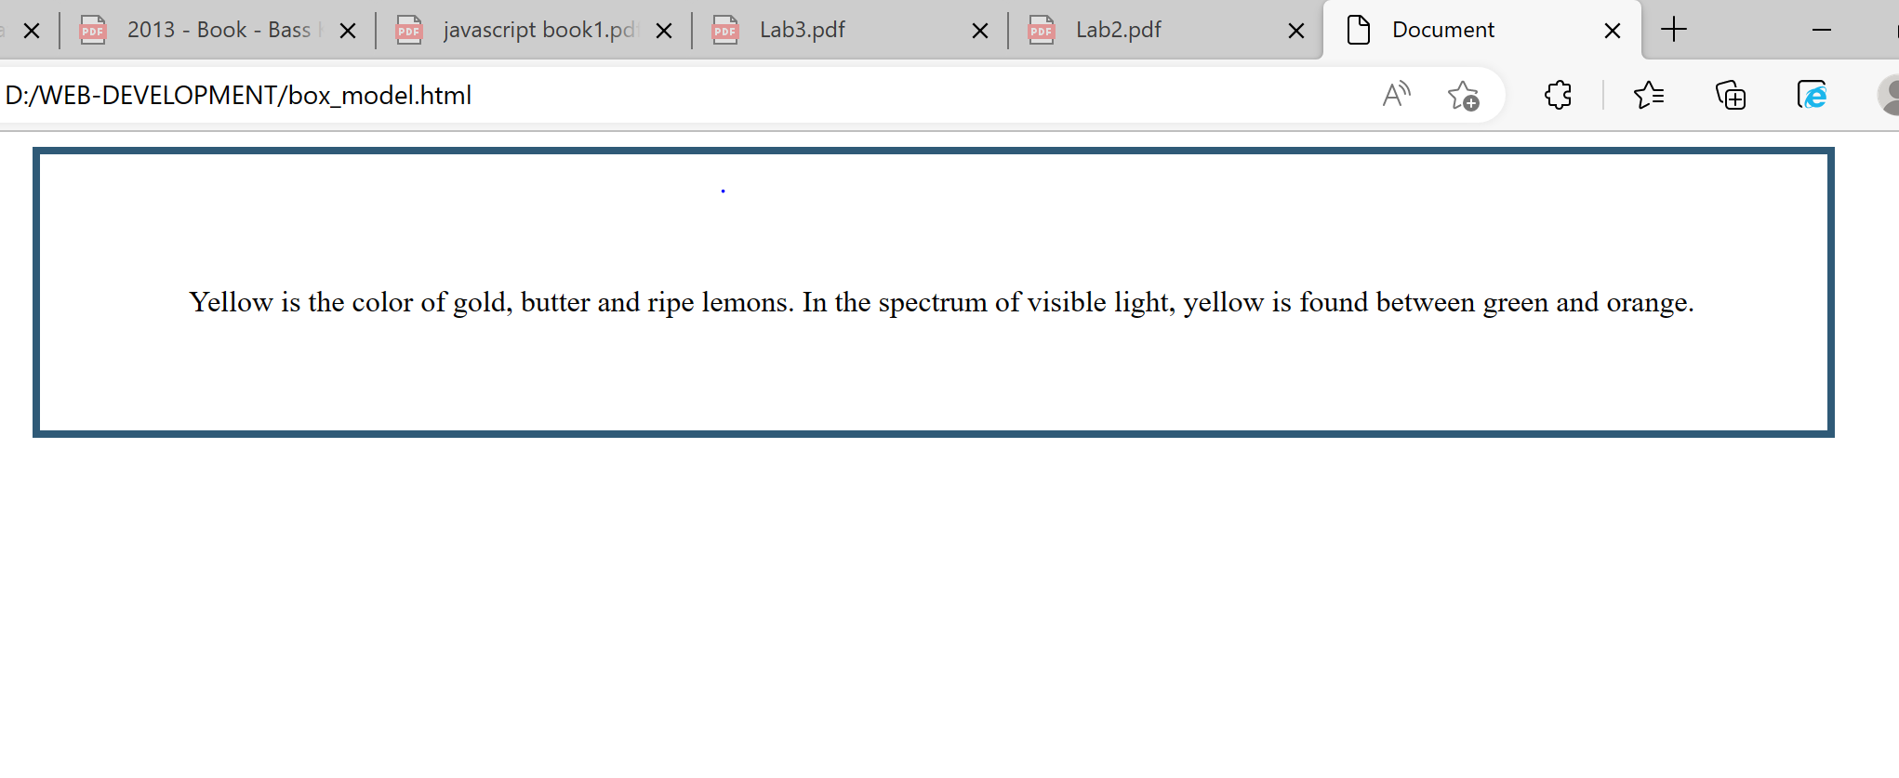
Big concept
Bring the attention of your audience over a key concept using icons or illustrations

Slide 11
BORDER
Allow you to specify the style, width, and color of an element's border.
Border can be applied to any block element.
Borders always come always come outside the padding area but inside the margin area.
Border properties cannot have negative values.

Slide 12
Border consists of:
Left Border
Right Border
Top Border
Bottom Border

Slide 13
BORDER STYLES
HTML
<body>
<div class="dot">A Dotted border.</div><br>
<div class="inset">An inset border.</div><br>
<div class="dash">A dashed border.</div><br>
<div class="mix">A mixed border.</div><br>
</body>
CSS
<style>
.dot { border-style: dotted;
width: 140px; }
.inset { border-style: inset;
width: 140px; }
.dash{ border-style: dashed;
width: 140px; }
.mix { border-style: dotted dashed solid double;
width: 140px;}
</style>

Slide 14
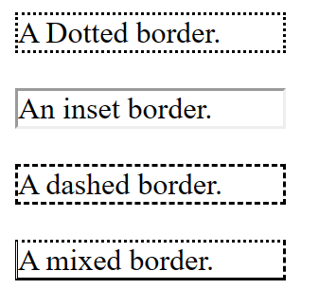

Slide 15

CSS POSITIONING
The position CSS property sets how an element is positioned in a document.
The positions that applied on CSS box.
Relative Positioning
Absolute Positioning

Slide 16
RELATIVE POSITIONING
HTML
<body>
<div class="absolute">1st box</div>
<div class="water">2nd box</div>
</body>
CSS
<style>
.absolute{ position: relative;
left: 30px; top: 70px;
width: 500px; height: 100px;
border: solid 3px; font-size: 24px;
text-align: center; }
.water { position: relative;
left: 80px; width: 500px;
height: 100px; border: solid 3px #ff7347;
font-size: 24px; text-align: center; }
</style>

Slide 17

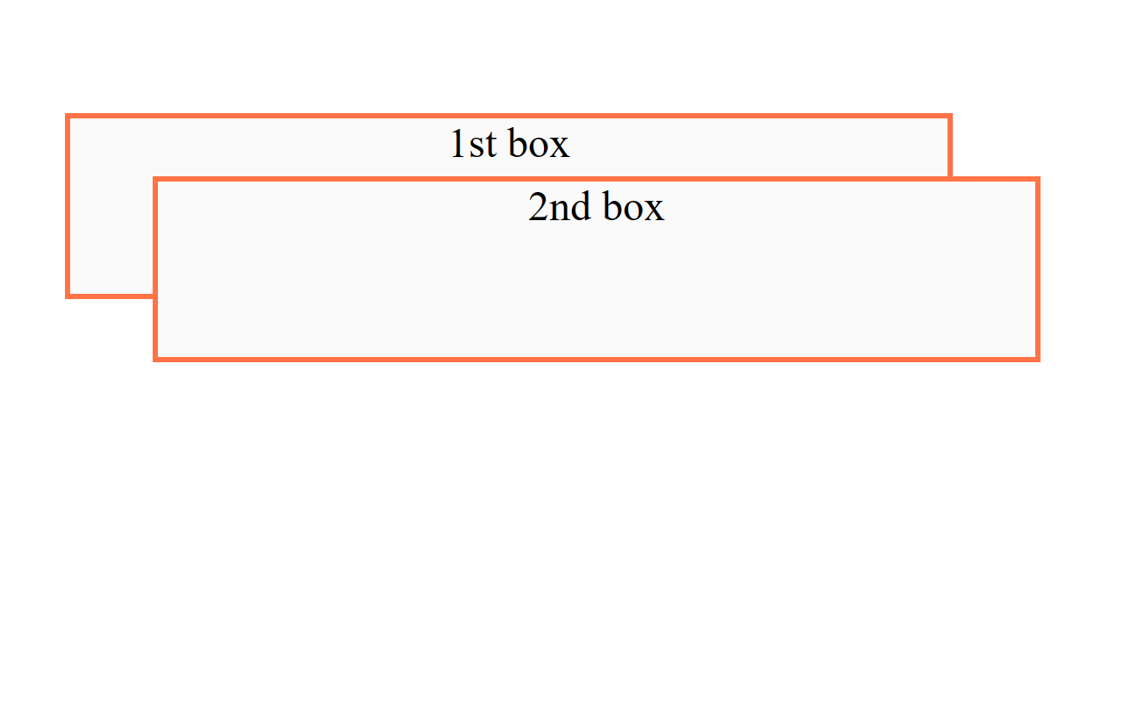
Want big impact?
Use big image.

Slide 18
RELATIVE POSITIONING
HTML
<body>
<div class="absolute">
WATER
<div class="water">
FISH
</div>
</div>
</body>
CSS
<style>
.absolute { position: relative;
left: 30px; top: 70px; width: 500px;
height: 500px; border: solid 3px;
font-size: 24px; text-align: center; }
.water { margin-top: 300px;
position: relative; left: 240px;
width: 100px; height: 100px;
border: solid 3px #ff7347; font-size: 24px;
}
</style>

Slide 19
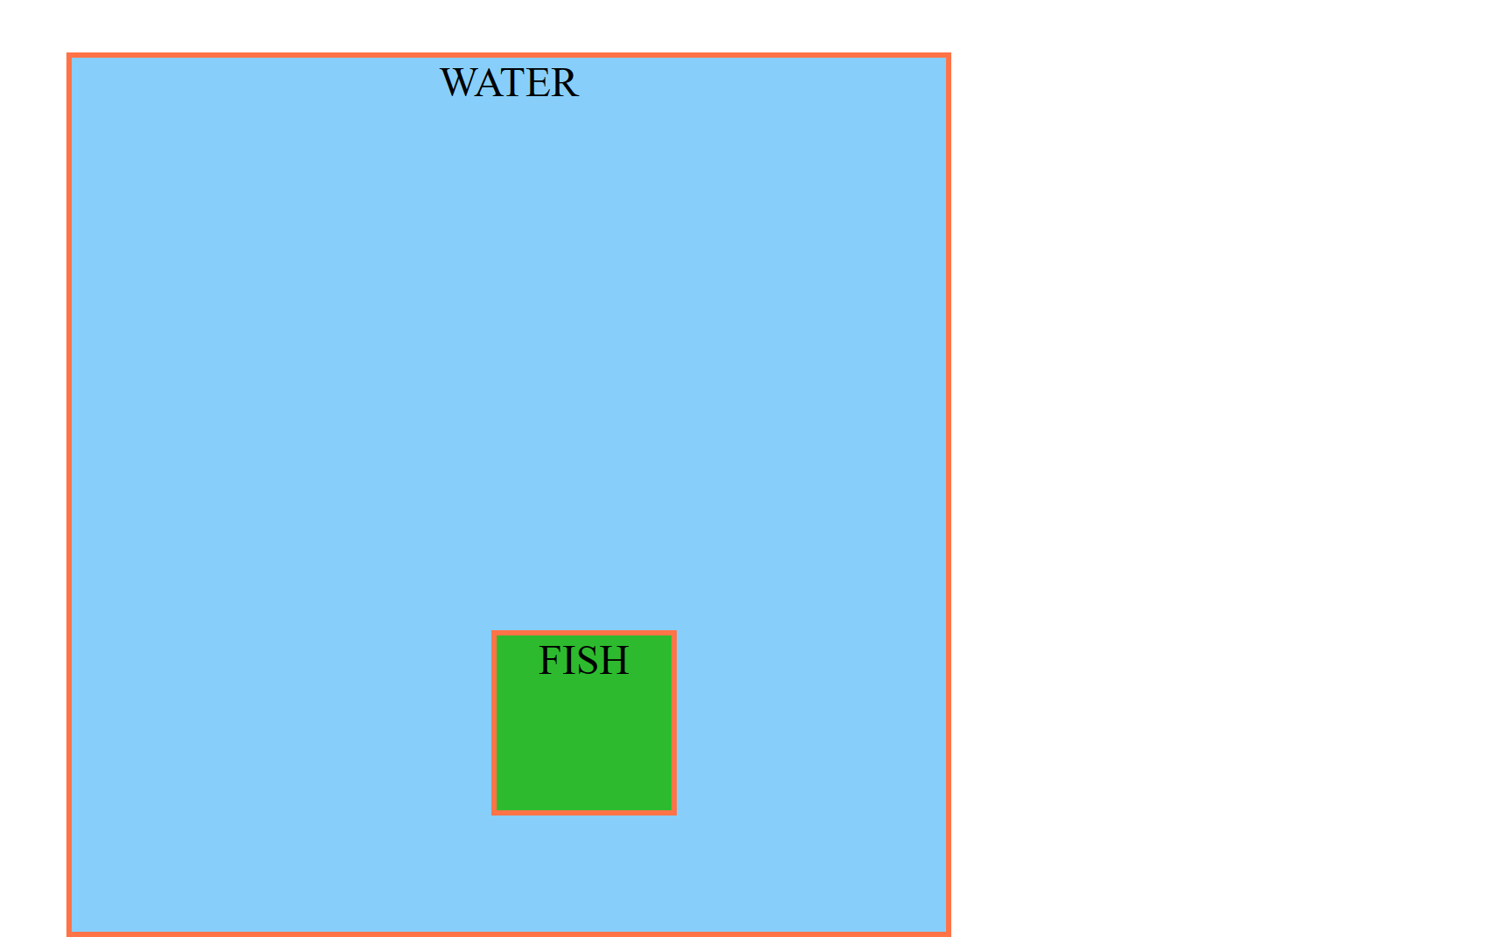
Want big impact?
Use big image.

Slide 20
Thanks!
Any questions?

